Slide 1


ENGAGING
WITH
VOLUNTEERING
CCCA3

Slide 2

Learning outcomes
By the end of this session, you should be able to:
Discuss and express your opinions on issues such as your own experiences, volunteering and how volunteering can help.
Develop empathy and emotional intelligence skills
Use vocabulary related to volunteering
Infer information from listening

Slide 3
OUTLINE
Warm up
Definition
Areas of volunteering
Benefits of volunteering
Statistics
Volunteer rights and responsibilities
Selecting a volunteer role
Volunteer Organisations
Tunisian Examples
Vocabulary
Quiz
CCCA3 Project

Slide 4


Slide 5

Warm up
If you could volunteer for a charity or a cause, what would you like to volunteer for?

Slide 6

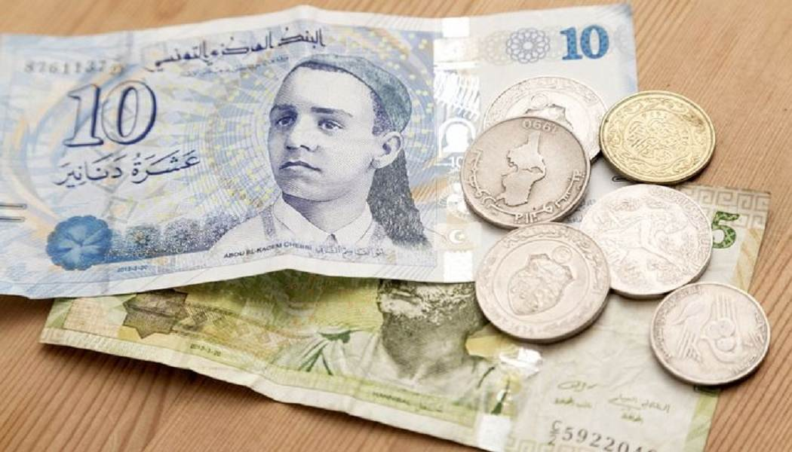

Warm up
Is it better to donate your , or to a cause? Why?
money
time
skills

Slide 7
Warm up
What motivates people to volunteer their time for free?

Slide 8
DEFINTION
A volunteer: a person who does something, especially helping other people, willingly and without being forced or paid to do it.
To volunteer: to offer to do something that you do not have to do, often without having been asked to do it and/or without expecting payment:

Slide 9

What is volunteering?
Volunteering is time willingly given for the common good and without financial gain.
Volunteering means giving your time and abilities to aid others (usually a non-profit organization) without the want of financial compensation.
Volunteering is a voluntary act of an individual or group freely giving time and labour for community service. Many volunteers are specifically trained in the areas they work, such as medicine, education, or emergency rescue. Others serve on an as-needed basis, such as in response to a natural disaster. Nowadays, one common type of volunteer is volunteer tourism.

Slide 10
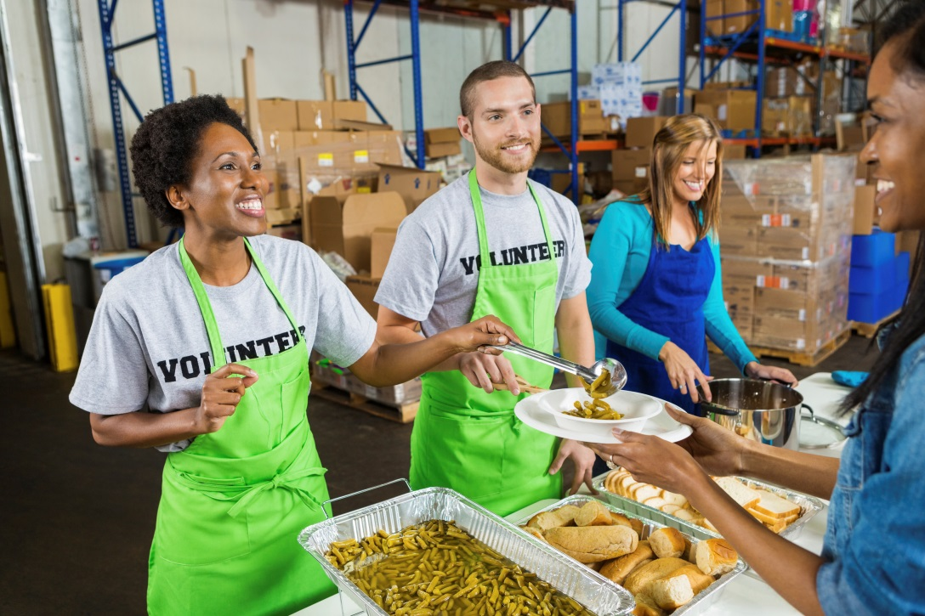
Areas of volunteering
Soup Kitchen
Help to serve food to people in need.
Notes:
Ask: Is there a charity meal service in your area?

Slide 11

Areas of volunteering
Op-Shop volunteering
Collecting, sorting and selling donated goods in charity stores.
Notes:
Ask: What is an op shop? Have you been to an op shop? Did you know that most of the people who work there are volunteers? What skills do you think you would learn, doing this work?

Slide 12

Areas of volunteering
Helping in community organisation’s offices
Answer phones, do bookkeeping or filing for charities and not for profits.
Notes:
Ask: what are some other things you might do in an office?

Slide 13
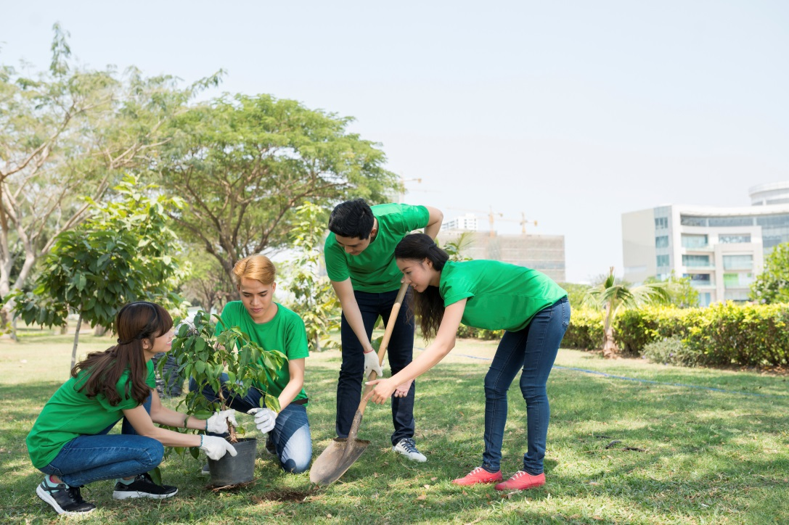
Areas of volunteering
Helping with the environment
Taking part in tree planting.
Notes:
Ask: what are some other ways of helping with the environment? Eg cleaning up parks and gardens.

Slide 14
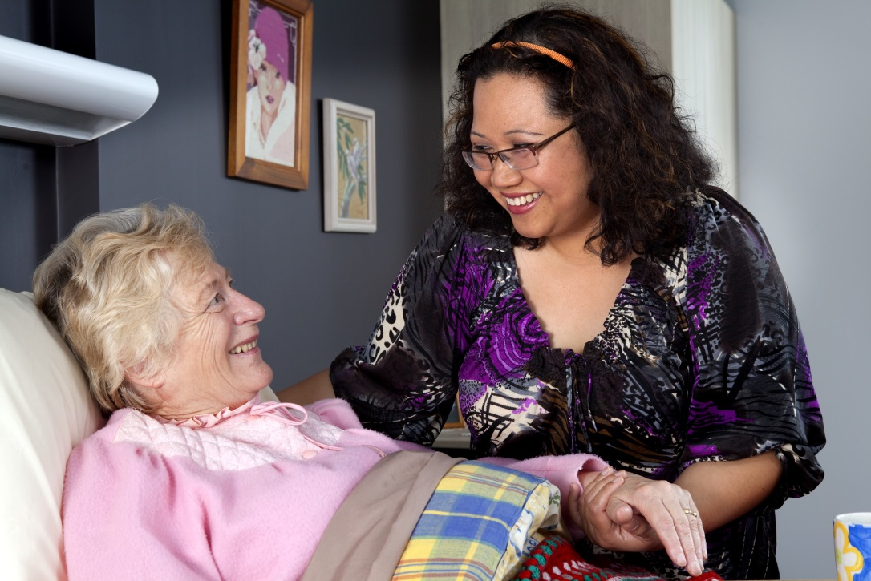
Areas of volunteering
Elderly support
Help older people with their shopping, or take them out for a walk. Visit and talk with them at home or in aged care centres
Notes:
Ask: How else could you help older people? Drive them to appointments or events. Take them to the movies etc.

Slide 15
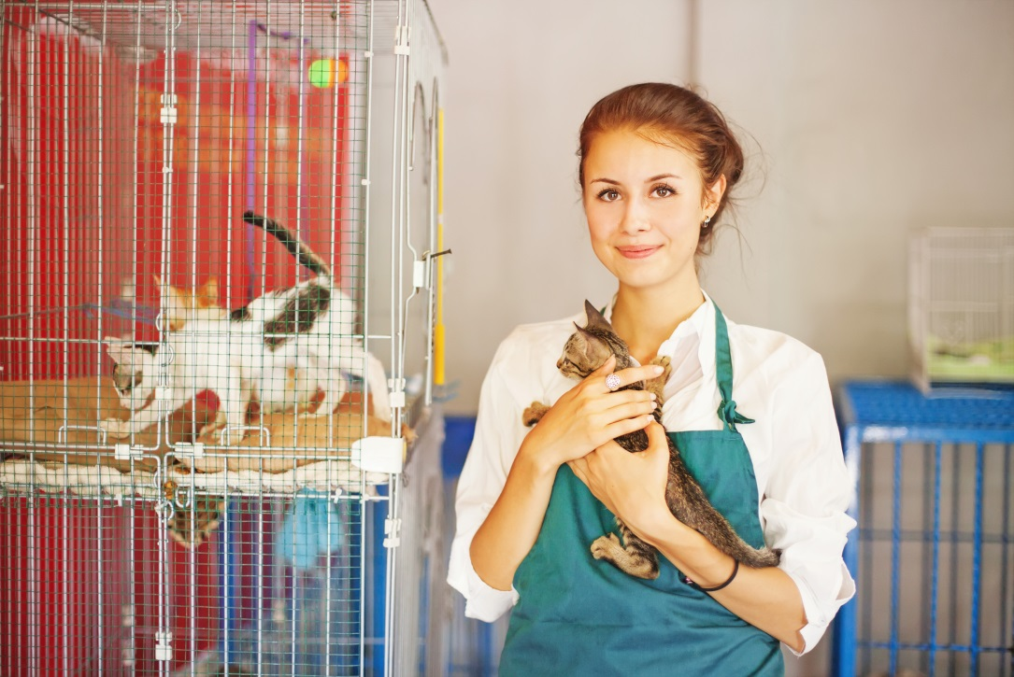
Areas of volunteering
Helping with animals
Helping hurt animals and homeless animals.
Notes:
Ask: Who likes working with animals? Volunteers can work in homeless animal shelters, helping to care for animals. Or, if they have the space, can help a wounded native animal to recover by looking after them at home. People can also volunteer to walk the dogs of elderly people who have difficulty walking.

Slide 16
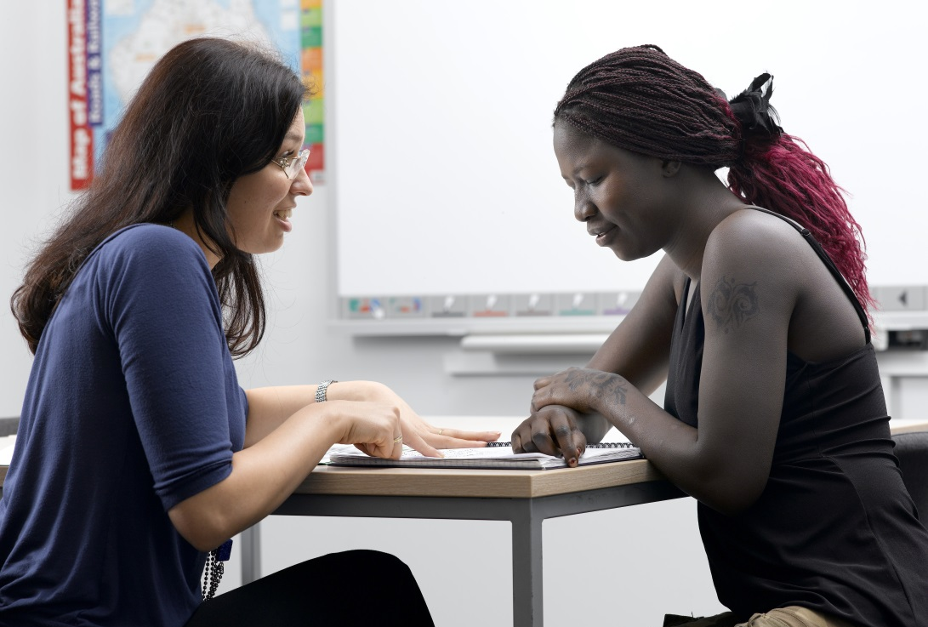
Areas of volunteering
Tutoring
Helping people to learn how to use computers, mobile phones and tablets or helping in a homework club.
Notes:
Some community houses and libraries have information sharing programs. If you have IT skills, you can approach the library or your local community house and ask how you can help

Slide 17
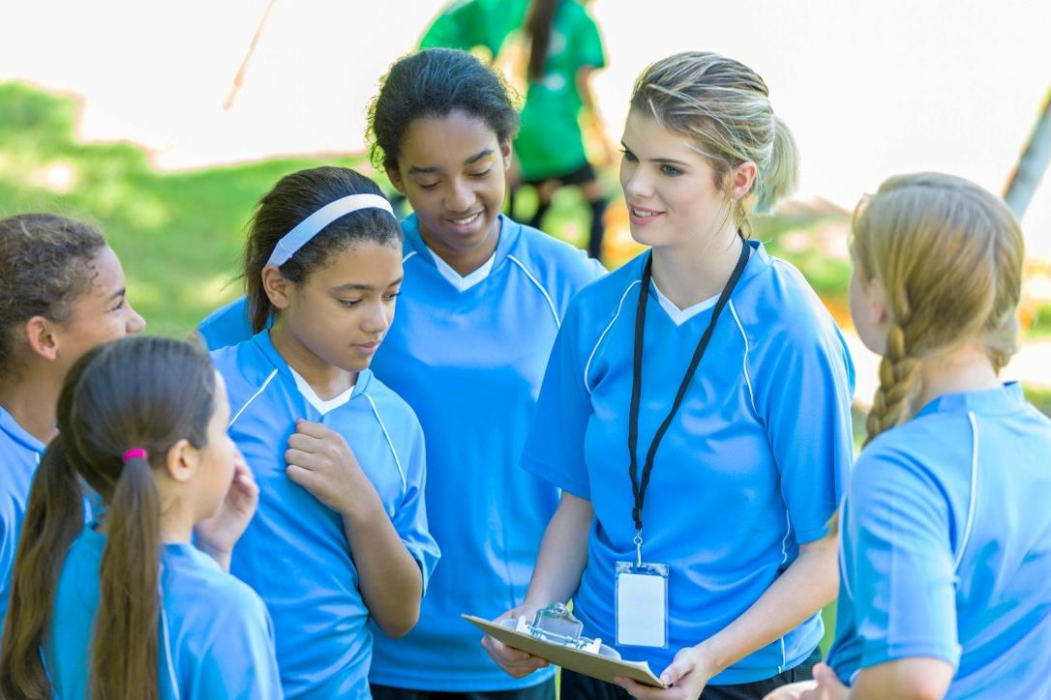
Areas of volunteering
Volunteering in Sports
Helping with local sports groups.

Slide 18
What work you'd be most interested in doing for your community?
Let’s find out! Take this quiz!

Slide 19
Volunteer Personality Quiz
1. In a working situation, which would you most likely do?
a. Work outdoors or with animals.
b. Teach and mentor others.
c. Work as a team, or collaborate with others.
d. Work by yourself with numbers and data.
2. Which word best describes you?
a. Active.
b. Enthusiastic.
c. Creative.
d. Organized .

Slide 20
Volunteer Personality Quiz
3. If you could meet one of these people who would it be?
a. Marshawn Lynch
b. Nelson Mandela
c. Lady Gaga
d. Mark Zuckerberg
4. What would your favorite class of the day be?
a. Physical Education
b. Social Studies/Contemporary World Problems
c. Ceramics
d. Math

Slide 21
Volunteer Personality Quiz
5. When faced with a problem, what is the first thing you usually do?
a. Come up with a strategy to solve the problem
b. Gather information to try and find out what caused the problem
c. Visualize the problem, and how you may be able to solve it
d. Figure out the details of the problem
6. How do you like to spend your summer vacation?
a. Camping
b. Spending time with friends and relatives
c. Taking and editing photos
d. Taking a Class of Interest

Slide 22
Volunteer Personality Quiz
7. During Spring Break, would you rather
a. Take a trip to Costa Rica
b. Volunteer to build homes with Habitat for Humanity
c. Visit a museum, or go see a play
d. Research your Genealogy
8. Which item would you rather receive as a gift for your Birthday?
a. Sports equipment
b. Donations to your favorite charity, made in your name
c. Music and Art supplies
d. Latest Technological Gadget
9. Your idea of a great job?
a. Professional athlete
b. Grants Manager for Gates Foundation
c. Photographer for National Geographic
d. Executive with Microsoft/ Apple or Google

Slide 23
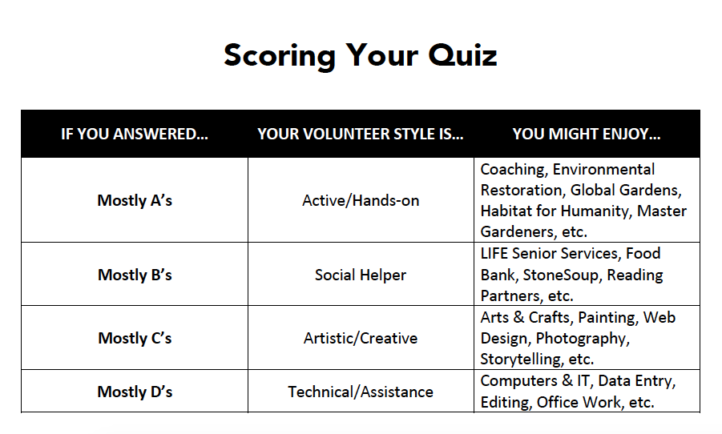

Slide 24
Have you, or anyone you know, benefited from volunteers?
What are the benefits of volunteering for the volunteer?

Slide 25
Benefits of volunteering
Gain confidence. Volunteering can help you gain confidence by giving you the chance to try something new and build a real sense of achievement.
Make a difference. Volunteering can have a real and valuable positive affect on people, communities and society in general.
Meet people. Volunteering can help you meet different kinds of people and make new friends.
Be part of a community. Volunteering can help you feel part of something outside your friends and family.

Slide 26
Benefits of volunteering
Learn new skills. Volunteering can help you learn new skills, gain experience and sometimes even qualifications.
Take on a challenge. Through volunteering you can challenge yourself to try something different, achieve personal goals, practice using your skills and discover hidden talents.
Have fun! Most volunteers have a great time, regardless of why they do it.

Slide 27
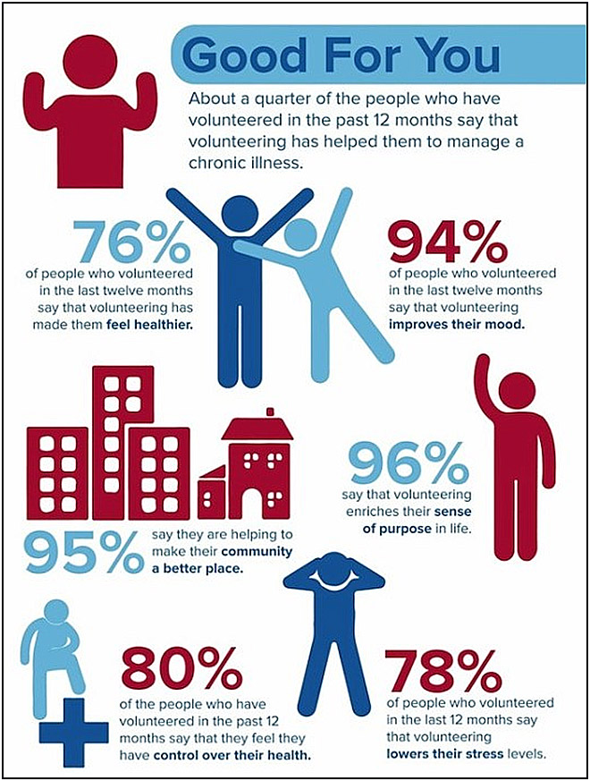

Slide 28
Statistics
Women volunteer at higher rates (27.8%) than men (21.8%).
People aged 35-44 and 45-54 are most likely to volunteer (28.9% and 28% respectively) while 20-24 year olds have the lowest rates (18.4%).
On average, people spend an average of 52 hours per year volunteering their time.
72% of volunteers are involved with only one organization, while 18.3% are involved with two.
The top four volunteer areas are for religious (34.1%), educational (26%), social service (14.9%), and health (7.3%) organizations.

Slide 29

Volunteer rights and responsibilities
Volunteer Rights:
To have a healthy and safe environment
To be covered by insurance
To have a position description and agreed hours
To be provided with orientation and training
To be interviewed with equal opportunity
Volunteer Responsibilities:
To commit, be punctual and reliable
Notify your supervisor if you can not attend
To do the duties as set out in the position description
Agree to the organisation policies
Respect and support all team members
Report potential hazards
Notes:
You should get the same tea breaks and lunch breaks as paid workers. Treat it like any paid job. Arrive on time. Turn up on time. Let people know if you are sick and cannot come in.

Slide 30
Volunteer rights and responsibilities
Generally, you can expect:
To receive satisfaction from the role you are doing
To receive assistance and training if required
To be a respected and valued member of the team
To receive feedback on your performance
To have policies and processes to follow
Notes:
Explain each point as it presents.

Slide 31

Selecting a volunteer role
Volunteer resource centres support all aspects of volunteering in their community.
They have a database of volunteer opportunities and can talk to you about your skills and interests. They can suggest community organisations that you might like to engage with.
Some Volunteer organisations advertise their positions online.
You can apply directly to those advertisements.
Read the position description and make sure you understand what you have applied for and think about the questions you need to ask.

Slide 32

Volunteer Organisations
The recruitment process:
Apply
Interview
Police Checks/Working with Children Checks
Training and orientation
Engage
Review

Slide 33
Volunteer Organisations
Volunteer organisations
Big Volunteer Involving Organisations may have a Manager, a Volunteer Coordinator and a Supervisor.
Small Volunteer Involving Organisations may have only one person doing all the roles.
Some of the Managers, Coordinators and Supervisors you meet may also be volunteers.

Slide 34
Volunteer Organisations
A Manager/Coordinator/ Supervisor of Volunteers will:
  Interview you
  Explain the volunteer position
  Assist you with applying for police checks
  Organise orientation and training
  Help volunteers to get started
  Be available for on-going support
  Review volunteer performance and provide feedback
The Manager/Coordinator/
Supervisor of Volunteers is responsible for the delivery of the program so will want to help volunteers do their role well.

Slide 35
Tunisian Examples

Slide 36
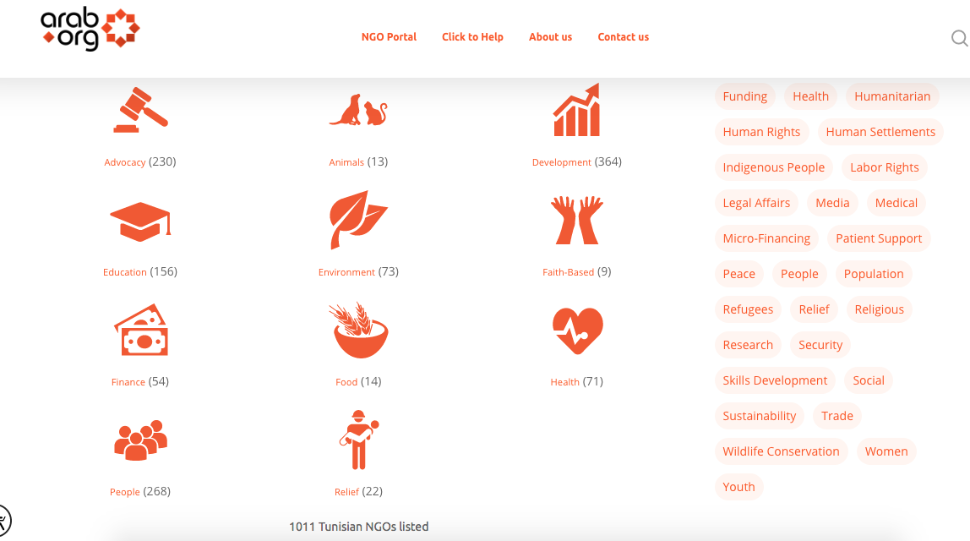

Slide 37
Vocabulary
(to) volunteer (verb, noun) – to give your time, labour or skills for free to help a cause or event; someone who volunteers.
the voluntary / third / not-for-profit sector (noun) – organisations whose purpose is to benefit society rather than to make a profit.
gap year (noun) – a period of time, often before or after university, when people participate in a personal experience such as travelling or volunteering.
worthy cause (noun) – a cause that provides a lot of value to society, especially a charitable cause.
to give (something) back to the community (saying) – to help or volunteer for a worthy cause as a way of repaying or acknowledging the contribution society has given to the volunteer.
to pay it forward (saying) – to respond to a person's kindness by performing an act of kindness to another person.

Slide 38

complete the following sentences by using the vocabulary in the correct form:
a: (to) volunteer
b: the voluntary / third / not-for-profit sector
c: gap year
d: worthy cause
e: to give (something) back to the community
f: to pay it forward
1. Every Friday night I volunteer to give food to the homeless people in our city; it's just my little way of ………………………..
2. “Thank you so much! That's so kind of you; how can I ever repay you?” “Don't worry! It's no problem whatsoever; just …………………………”
3. Helping victims of landmines is such a ………………… .
4. Janet ……………….. at the local children's hospital in her free time.
5. During my…………………….after finishing university, I volunteered to help build a school in
Zambia.
6. The government announced that it would abolish taxes for the ………………….
giving something back to the community
pay it forward
worthy cause
volunteers
gap year
voluntary sector

Slide 39


Slide 40
HOW MUCH DO YOU KNOW ABOUT VOLUNTEERING?
TAKE THIS FUN QUIZ TO FIGURE OUT HOW CONNECTED YOU ARE TO THE WORLD OF VOLUNTEERING AND TO SEE HOW VOLUNTEER SAVVY YOU ARE!

Slide 41

New York
Rome
São Paulo
All of the Above

Slide 42
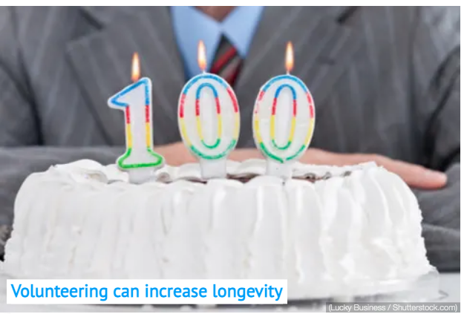
Volunteering can increase longevity
True
False

Slide 43
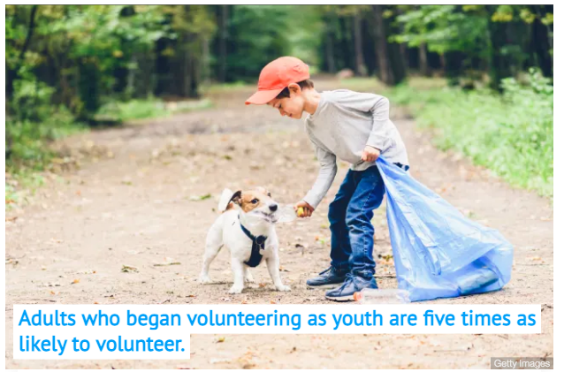
True
False

Slide 44
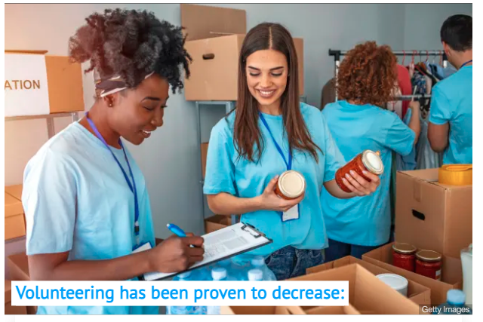
Blood pressure
Cholesterol
Diabetes
Dementia

Slide 45

India
Peru
Thailand
Kenya

Slide 46
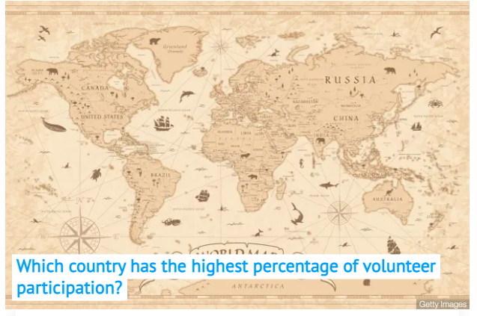
United States
Germany
Canada
Turkmenistan

Slide 47

Khloe Kardashian
Taylor Swift
Hillary Swank
Jennifer Aniston

Slide 48
To recap
Volunteering your time, skills, and resources is one of the most powerful ways to make a difference, to help others, and as it turns out, to enhance your wellbeing.
Change your world …
START NOW!

Slide 49

CCCA3 PROJECT
“NGO, stand for your cause!”

Slide 50
This project will help you acquire these Soft Skills:
empathy
teamwork
Problem solving and decision making
Planning skills
communication
Social intelligence
Presentation skills
Emotional intelligence

Slide 51
Introduction
Have you ever seen a problem and wanted to do something about it? Of course you have. The schools, police, government welfare offices and families aren’t handling it.
Others share your concerns and want to do something. That’s why you would start a nongovernmental organization, your own NGO.

Slide 52


Slide 53
Overview
NGOs are organizations that are independent of government involvement. They are known as non-governmental organizations or non-government organizations, with NGO as an acronym. NGOs are a subgroup of organizations founded by citizens, which include clubs and associations that provide services to their members and others. NGOs are usually nonprofit organizations, and many of them are active in humanitarianism or the social sciences.

Slide 54
Objective
Nongovernmental groups have been at the forefront of major social movements to improve people’s lives.
Most NGOs are founded by people who are passionate about their communities or causes. Yet starting and running an NGO takes more than passion. It takes knowledge, skills, resources and relationships. It also takes time, planning, patience and flexibility. To be effective, an NGO needs to be legitimate, transparent and accountable.

Slide 55
Main aim
Added to that, NGOs can play a key role in the march towards the attainment of Sustainable Development Goals (SDGs) 2030. Therefore, in this project, you will become familiar with the variety of ways in which NGOs work to bring about sustainable change in TUNISIA. It is your turn now to start building your own local NGO!

Slide 56

Lits of Sustainbale Developent Goals:
Your NGO is required to mobilize around the Sustainable Development Goals (SDGs) to be implemented at the national level.
(NGO ideas must not be of any sexual, political or religious aspect.) + (Avoid all virtual issues -such as cyberbullying or cybercrime- causes have to be concrete and existing in the Tunisian society.)

Slide 57
General requirements
You are asked to:
You are asked to start and build your own NGO by first identifying what causes you are passionate about in Tunisia: emergency relief, women’s rights, economic development... (please refer to the list of sustainbale developent goals (SDG’s))
Organise the hierarchical system depending on your management style: you should assign everyone in the group a clear role: There needs to be a board of directors, administrators, fundraisers, project managers, educators, ect.
Clarify your vision and goals: What is the purpose of your NGO?
Conduct local research, network, and form an action plan: you need to research the areas you want to work in: Identify the challenges, cultural history, political state, ect.
Identify your budget and fundraising process: to figure out where you will get the money from: loans, grants, private donations, membership dues, ect.

Slide 58
Weekly-detailed requirements:
Week 3: Project launch
Assignment 1: PPT
Week 5: PPT
Assignment 2: Awareness campaign (graphic)
Week 7: Awareness campaign (graphic)
Assignment 3: Awareness campaign (media)
Week 9: Awareness campaign (media)
Assignment 4: PPT and animated video
Week 11: Final PPT and animated video

Slide 59
Weekly-detailed requirements:
Week 3: “Project launch”
Brainstorming ideas, groups dividing up.
Assignment 1: PPT
You are asked to prepare a PPT presentation highlighting the following:
Name of the NGO & name of the group.
Organization: Introduction of the board of directors: The board of directors is the body responsible for governing the organization. The board makes sure an NGO’s mission is carried out legally, ethically and effectively. Ultimately, the board is accountable to the community the NGO serves, its donors and other partners.
Problem statement / chosen SDG
Values & vision
Mission (Solutions/proposals/action plan)
Possible Challenges & obstacles

Slide 60


Due to week: 9-15 OCT
Group mark
&
Individual mark

Slide 61

THANK YOU FOR YOUR ATTENTION!
ANY QUESTIONS ?

